Slide 1

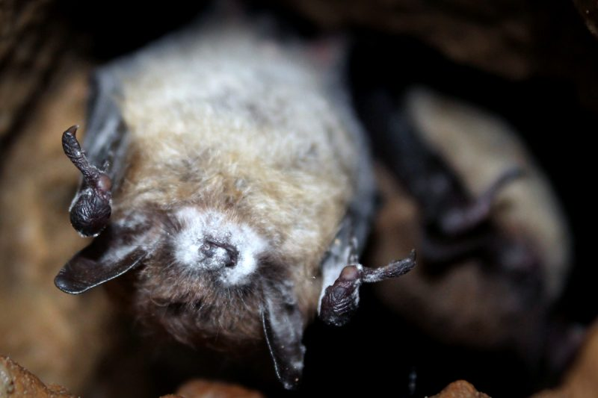

White Nose Syndrome; “No, not that scene from Scarface”
Modeling Disease dynamics of White-Nose Syndrome in a Little Brown Bat (Myotis lucifugus) Metapopulation
EDWARD KONG, PRANAV SADANA, JOEY THOMPSON

Slide 2
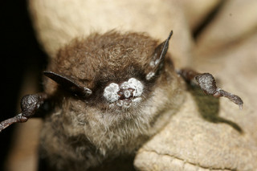
What is White-nose Syndrome (WNS)
A fungal infection (Pseudogymnoascus destructans)
First case in 2006
Grows on hairless areas of bats
Wakes bats from hibernation
Bats die due to lack of fat stores
90-100% mortality rate

Slide 3
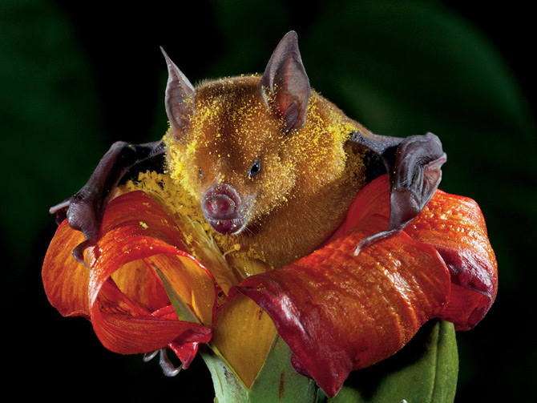
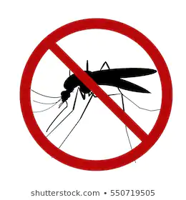
Why should we care?
Pollinators
Seed dispersers
Regulation of pests
Promote biodiversity
Indirect role in disease prevention

Slide 4
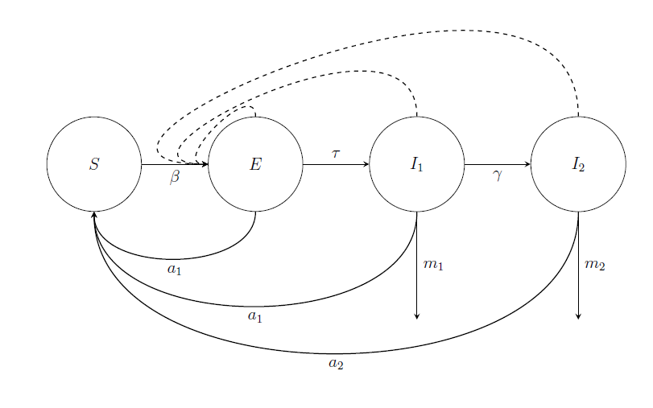
Our Main S.I. Model for a Population

Slide 5
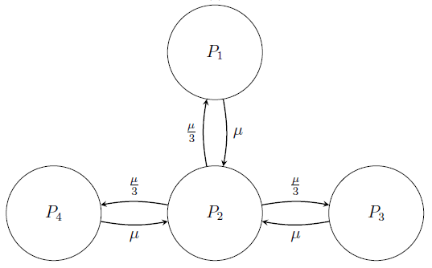
Our Metapopulation Model

Slide 6
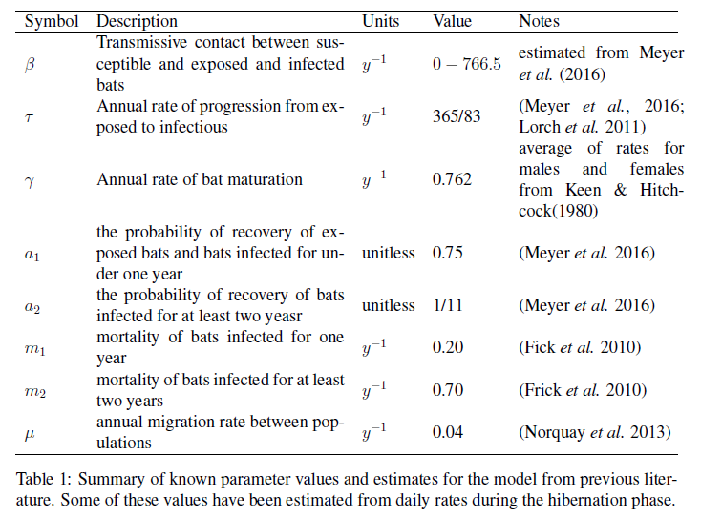
Parameter estimates

Slide 7
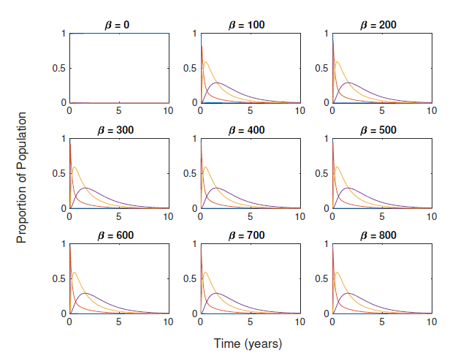
Sensitivity analysis of Beta (Contact rate)

Slide 8
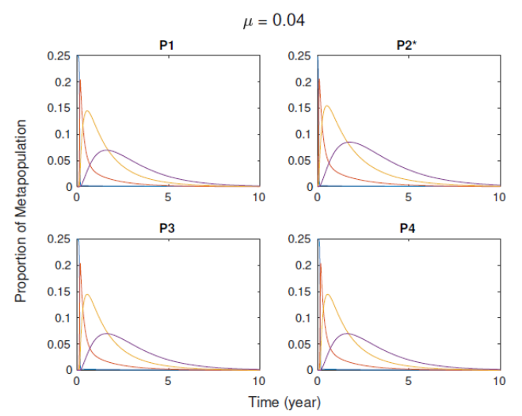
Sensitivity analysis of mu (Migratory rate)

Slide 9
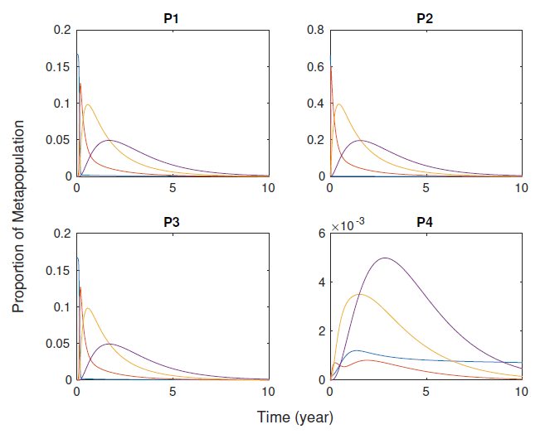
Effects of P. destructans on an initial large population size

Slide 10
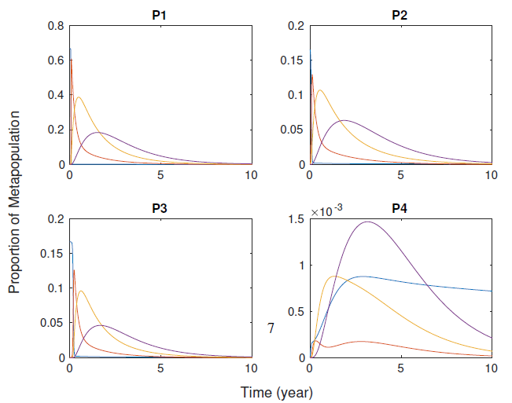
Effects of P. destructans on an initial small population

Slide 11
Strength of our model
-Highlighted significance of migratory rates on transmission of P. destructans across different caves
-Since P. destructans is a generalist pathogen, this result from our sensitivity analysis shows that further studies on the migratory patterns, rates bat populations that are more resistant to the fungus are required to help understand the overall transmission of P. destructans across North America
-Resistant bat populations may involuntarily act as vectors that could introduce the fungus to other populations of bats that are not as resistant to P. destructans since bats do roost in the same caves as other species of bats

Slide 12








Alternative factors that were not considered in our model
Sex Ratios of Migrants (Young Adult Bats)

Slide 13




Alternative factors that were not considered in our model
2. Caves as Environmental Reservoirs of P. destructans

Slide 14



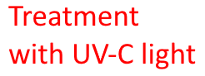

Conservation Ideas proposed by bat conservationists and mycologists
Mixed Ideas on concept of Human Intervention

Slide 15
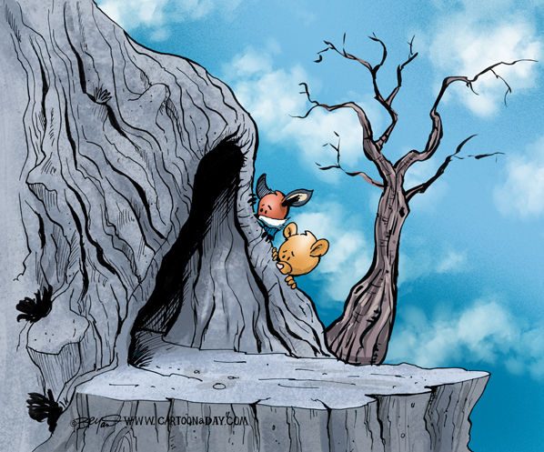
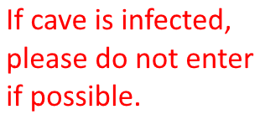
Our proposal on conservation efforts of bats
Try not to disturb infected sites as much as possible
More research needed on the microclimates of caves; temperature may help slow down the growth of the cold-adapted fungus

Slide 16
Thank you for listening.
Any Questions?

Slide 17
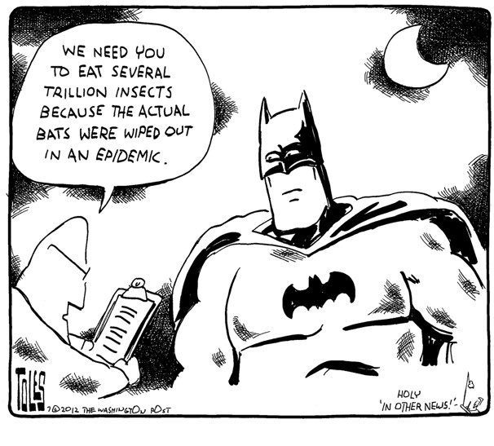
Like with adaptive radiation, there’s always going to be niches ready for filling.

